Slide 1
ModuLoop
Team 28 MDR: Conor Curtin, Evan Rovelli, Ryan Gordon, Shawn Colby
Advisor: Baird Soules
Evaluators: Professor Anderson & Professor Lorenzo
Notes:
Handout - 2 slides/page

Slide 2

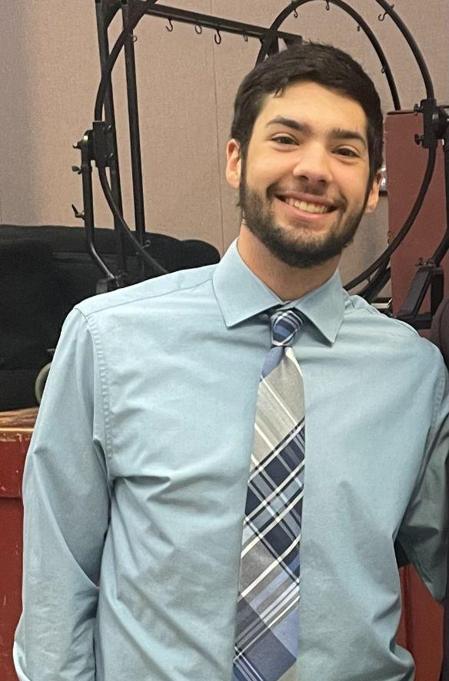


Team
Shawn Colby
Computer Engineering
Ryan Gordon
Electrical Engineering
Conor Curtin
Computer Engineering
Evan Rovelli
Computer Engineering

Slide 3
Problem Statement
Music creation has evolved over time and a lot of new technology has been incorporated into this process. There are many solutions designed to create backbeats and loops to aid musicians in creating music. However, a lot of these tools only have set features and are quite confusing for an inexperienced user to operate.
We have decided to design a solution that is more modular in its features and easier for the user to operate. Our device will be able to have varying steps for each beat in a looping measure. There will be different sounds and effects that can be swapped by the user to achieve various styles of music. The loops will be chainable, so multiple measures of music can be made.
Notes:
Ryan

Slide 4

Goal
We aim to develop a music sequencer that can use custom imported sounds along with sounds from a MIDI library to provide a user friendly, handheld platform used as a creative tool early in the production process of making music.
Notes:
Shawn

Slide 5
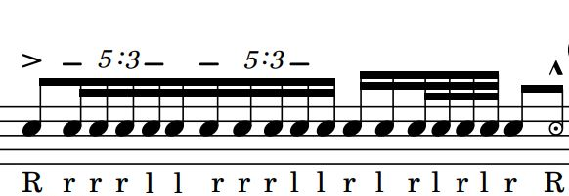
Terminology
Step - Moment in time when sound is output
Beat - Combination of one or more steps of equal length in succession
Measure - A collection of one or more beats in succession
Loop - A collection of one or more measures that is repeated
Tempo - The frequency at which beats occur in beats per minute (BPM)
MIDI - Standardized protocol & instrument library without defined sounds for music-making devices
General MIDI - Standardized instrument library with defined sounds
Notes:
Conor

Slide 6
Specifications
Specification | Test Plan
Produce accurate tempo down to smallest step interval within +/- 2% | Measure delay between steps and view output on an oscilloscope to measure the distance between peaks
High and low pass filters can be applied to final audio mix | Read effect of HPF & LPF in frequency domain using FFT oscilloscope feature
BPM is adjustable through a user input | Measure delay between steps and view output on an oscilloscope to measure the distance between peaks
Graphical user interface can be used to navigate preset & custom sound libraries and saved pattern configs | Navigate sound libraries and saved configurations
System is operable by both rechargeable battery and power supply | Independently demonstrate system powered from external power supply and battery
Notes:
Evan - 10 specifications
Think about how we are testing metronome accuracy
Metronome overlay? Record difference to metronome
UPDATE TEMPO ACCURACY
(60,000 mili-seconds)/((tempo (beat/min))*(steps/beat)))=83.333ms step interval
+/- 1.667 ms

Slide 7
Specifications Cont.
Specification | Test Plan
Allow user interchangeable custom sound files | Play custom sound files from external storage
Achieve at least four sounds layered per step | Mix minimum four sounds concurrently
Preset and custom sounds can be mixed together | Output mixed preset and custom sounds
System outputs to built-in speakers or line out | Display system sound through headphones or speakers
Device under the dimensions of a large tablet (under 13x13 inches) | Footprint dimension comparison
Notes:
Evan

Slide 8

CDR Deliverables
Button Matrix PCB integrated
Audio PCB integrated
Low and high pass filters functional
LCD displays MIDI sounds, SD sounds, BPM, steps per beat
Assign sounds from display to palette
Assign sounds from palette to measure matrix (LED indicating from which palette button
Overlap up 4 MIDI sounds and SD sounds on one step
Effects overlay measure matrix
Can change tempo using dial
Change number of steps per beat using LCD
Notes:
Add LED lights on step played, and palette button pressed

Slide 9
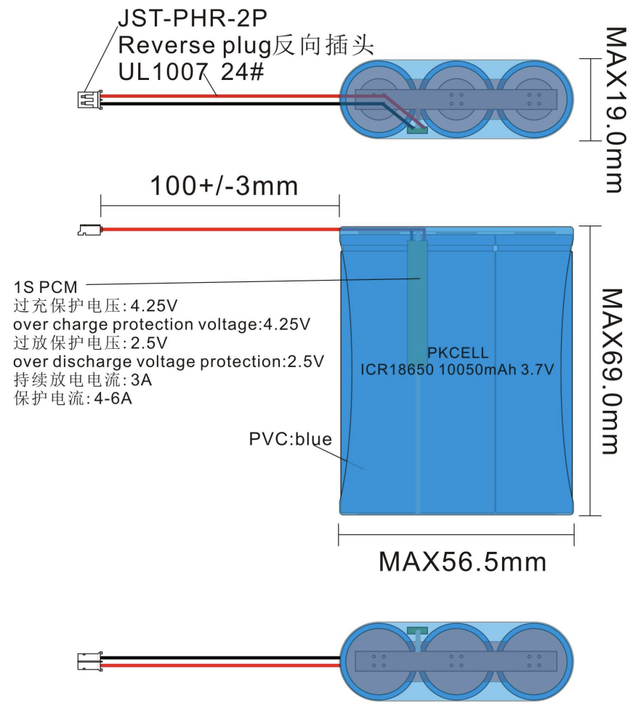
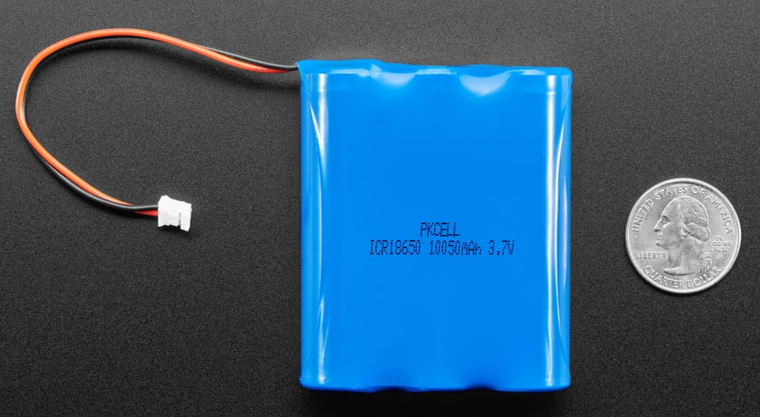
Battery Pack Selection
3x 18650 Lithium-ion battery pack
10050mAh at 3.7V ~ 37W/hr
Battery Management System (BMS)
overcharge protection at 4.25V
Under discharge protection at 2.5V
Current protection for 4-6A
Total system analysis ~4W
11.75hr system runtime
Notes:
Evan

Slide 10
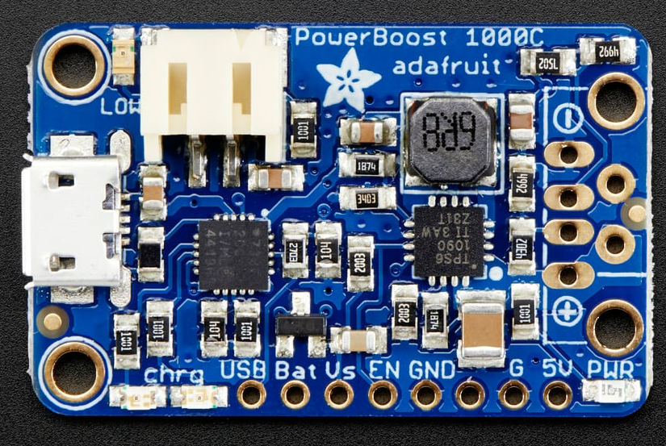
Battery Charger
Adafruit - PowerBoost 1000 Charger
Load sharing
Seamless operating dis/connecting to power supply
Buckboost nominal 3.7V → stable 5.2V
Integrates power switch cutting output
Enable pin shorted to ground disconnects output
Micro-USB charging input
90%+ operating efficiency
Battery indicator LED
Notes:
Evan

Slide 11
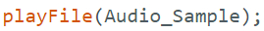
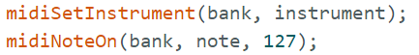
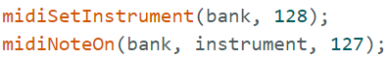
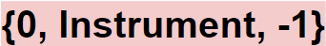
MIDI and SD Sounds Storage Methods
MIDI Melodic
All sounds stored in bank 1
Volume always set to 127 (max volume)
Each instrument has int associated
To play sound:
Set instrument to on
Call desired bank, note and volume
{1, Instrument, Note}
MIDI Percussion
All sounds stored in bank 0
Volume always set to 127 (max volume)
One Percussion “Instrument”
Note placeholder represents different instruments
To play sound:
Set instrument to on
Call desired bank, note and volume
SD Sounds
SD sounds are stored in audio sample objects on external PSRAM
To play sound: just call playFile function with desired audio sample cached on the PSRAM
{Audio_Sample}
Notes:
Shawn

Slide 12
Display to Palette to Measure Matrix
Display
MIDI Melodic:
{1, instrument, Octave, Note}
MIDI Percussion:
{0, instrument, -1}
SD Sound:
{Audio_Sample}
Palette
MIDI 2D Array:
{{1, 32, 60}, {-1,-1,-1}, {0, 40, -1},
{1, 45, 50}, … }
SD 1D Array:
{Crash, Bang, nullptr,
Guitar … }
Measure Matrix
MIDI 2D Array:
{{1, 32, 60, -1,-1,-1,...},
{0, 40, -1, 1, 45, 50,...},
{-1, -1, -1, -1, -1, -1,...},
…}
SD 2D Array:
{{Crash, nullptr, nullptr, nullptr},
{Crash, Bang, Guitar, nullptr},
{nullptr, nullptr, nullptr, nullptr},
…}
Notes:
Shawn
Mention what -1 means

Slide 13
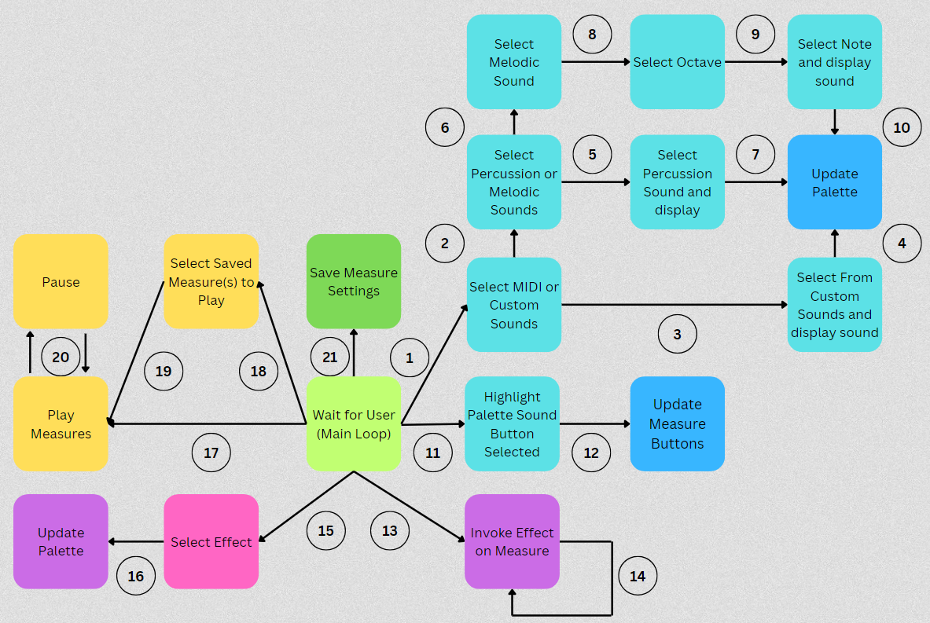
Software Block Diagram
Key
Select Sounds through display
Select MIDI sounds through display
Select Custom sounds through display
Select desired sound then a Palette button is selected
Select Percussion sounds through display
Select Melodic sounds through display
Select desired sound then a Palette button is selected
Select desired sound through display
Select desired octave through display
Select desired note then a palette button is selected
Palette button containing a sound is selected
Measure Matrix button is selected
Palette button containing an effect is selected
Loop until button is released
Select Effects through display
Select desired effect then a Palette button is selected
Play steps based on BPM timing independent of other states (except pause)
Select Saved Measures through display
Select desired saved Measure through display
Pause button selected
Select Save Measure through display
Notes:
Shawn
Cache that answer Shawn

Slide 14
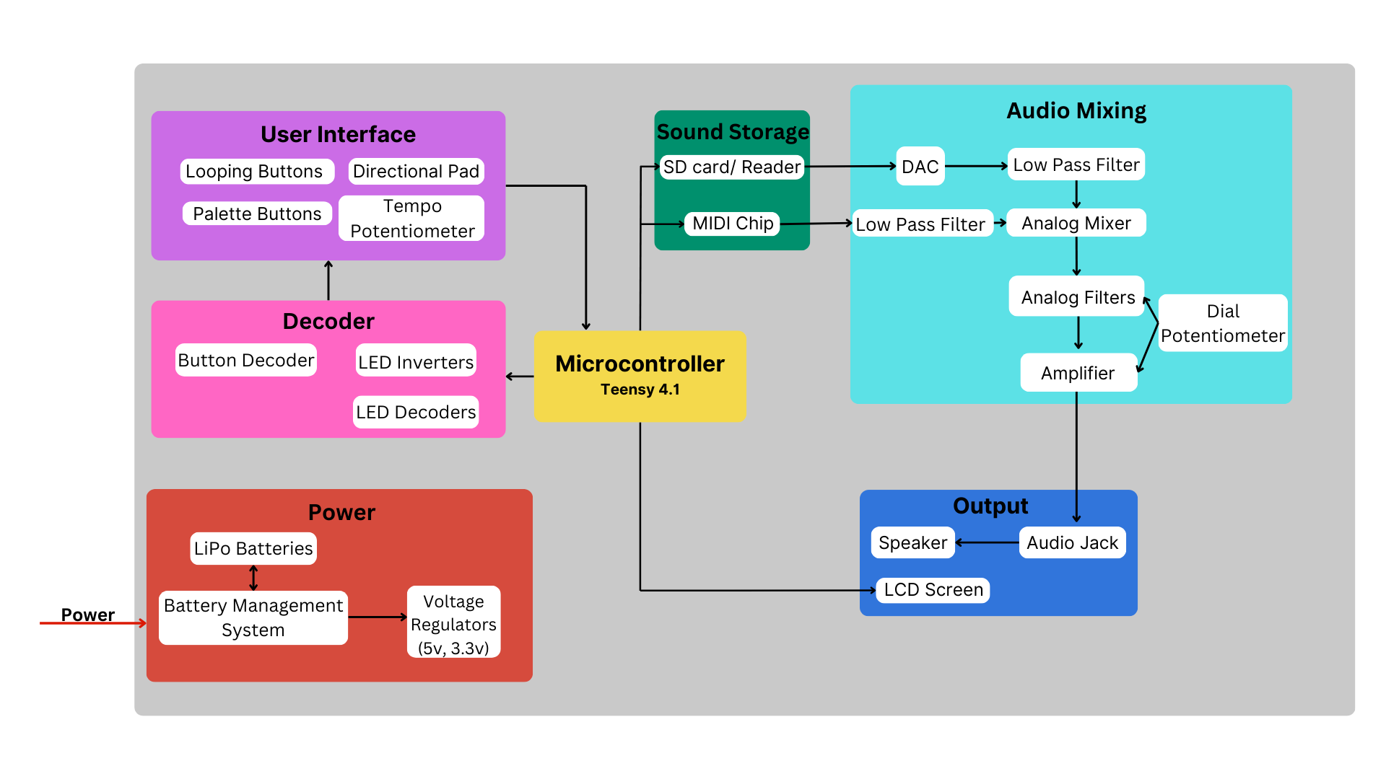
Hardware Block
Diagram
Notes:
Ryan
Specify processor details
Hardware photos after/ overlay

Slide 15
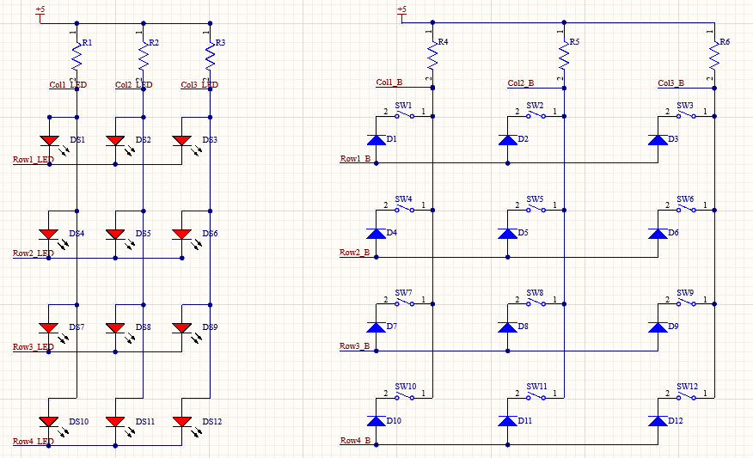
Button PCB
Schematic
Row column addressing
Rows can be linked to connected PCBs together

Slide 16
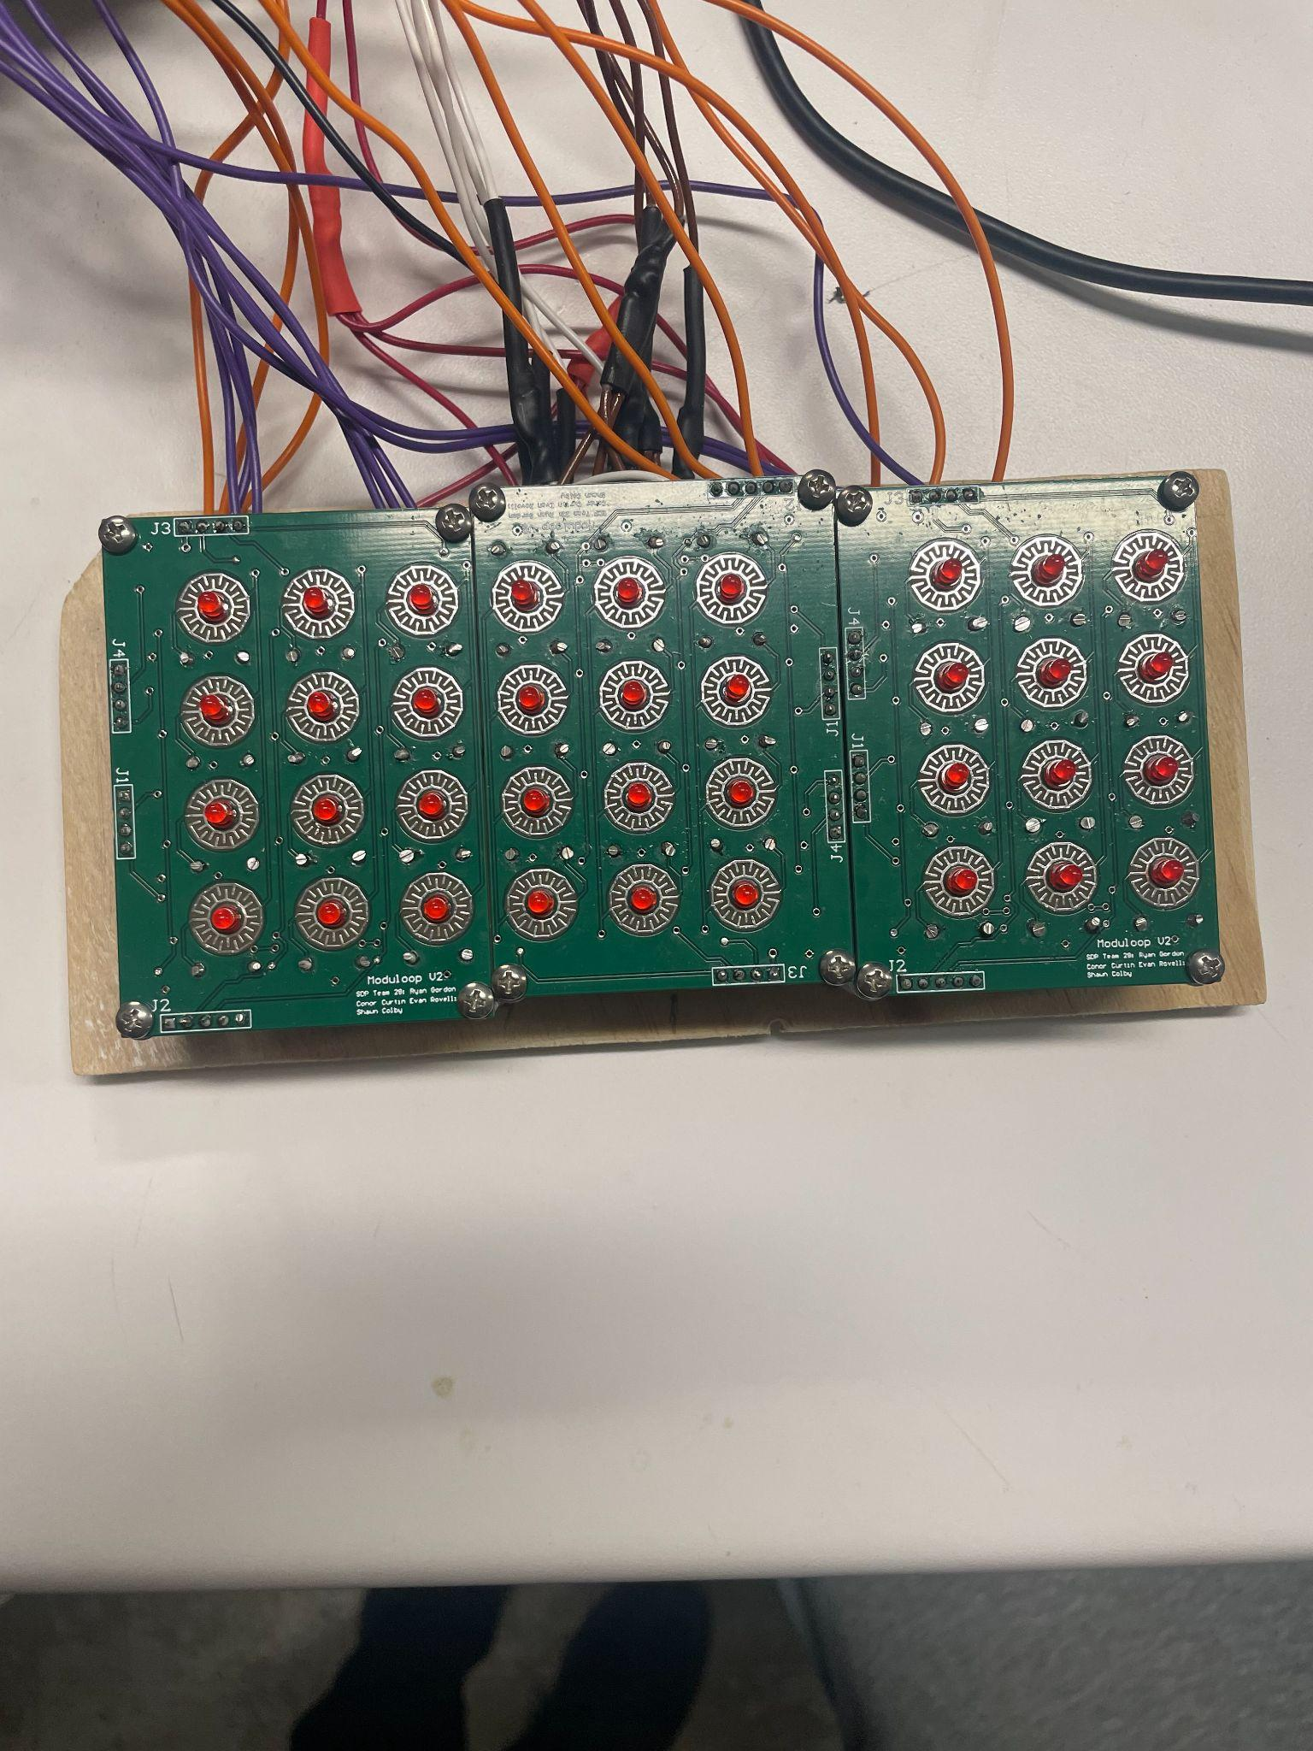
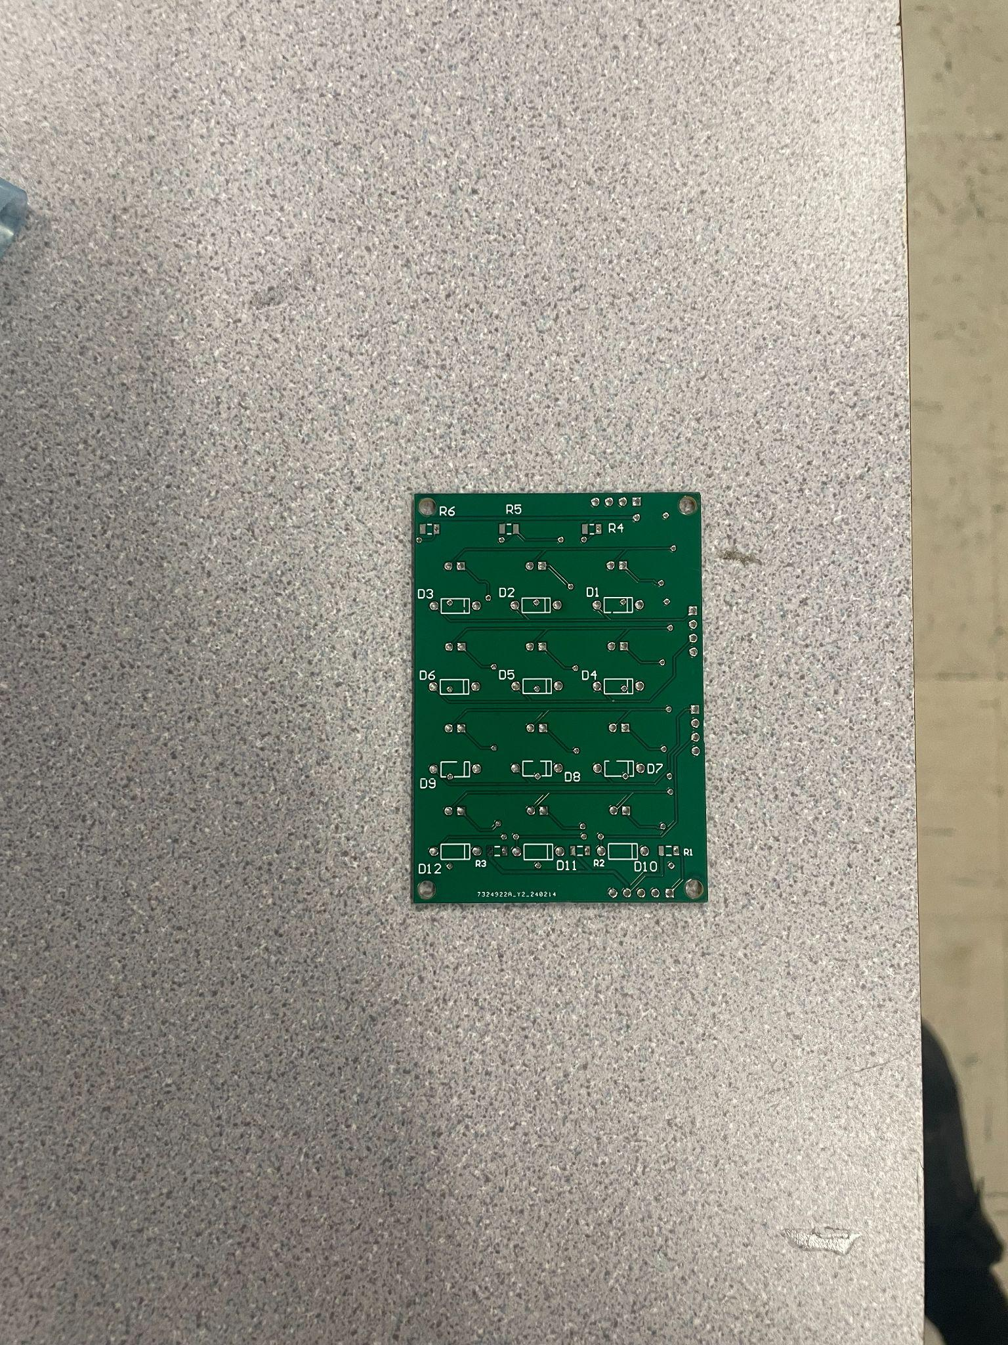
Button PCB

Slide 17
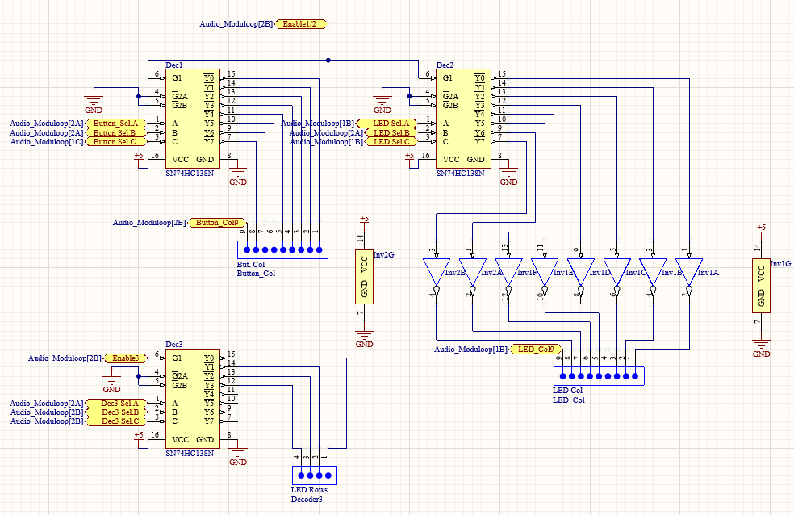
Button Decoders
74HC138N 3-8 decoders used to reduce pins from 26 pins to 18 pins
74HC04N Inverters used to set LED columns high when selected

Slide 18
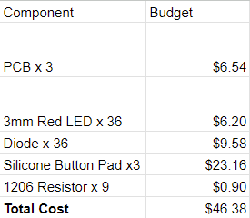
Button PCB BoM

Slide 19
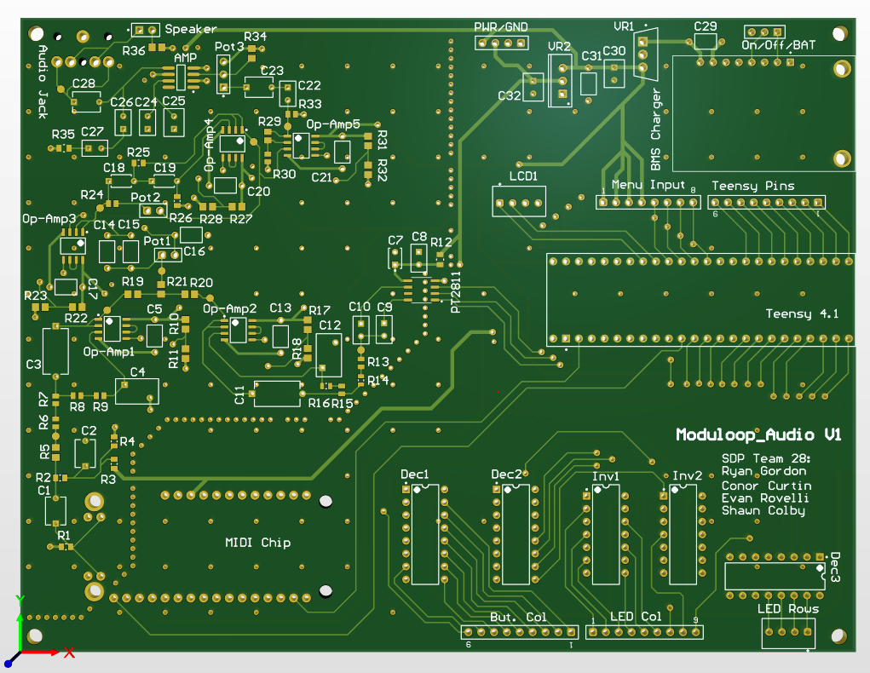
Audio PCB
4-layer mixed signal PCB
Via stitching to section off signal return paths

Slide 20
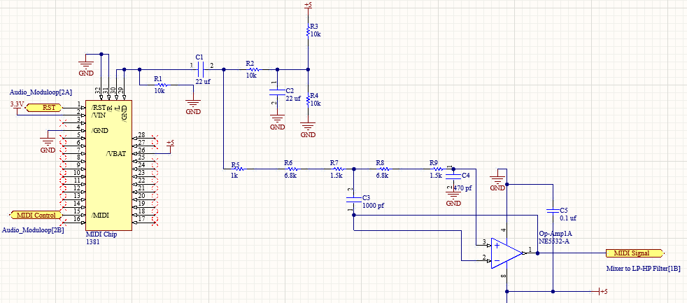
Audio PCB Schematic-MIDI
Notes:
Conor

Slide 21
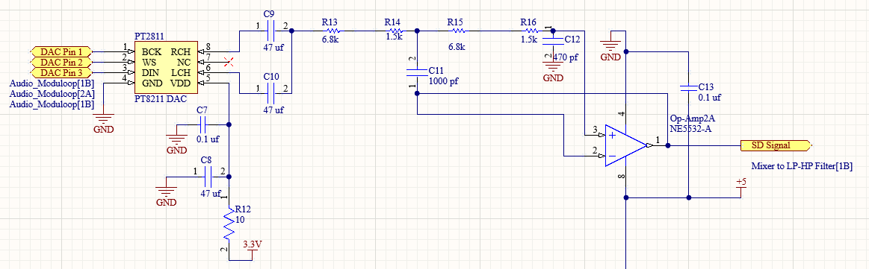
Audio PCB Schematic- DAC and LP Filter
Notes:
Conor

Slide 22
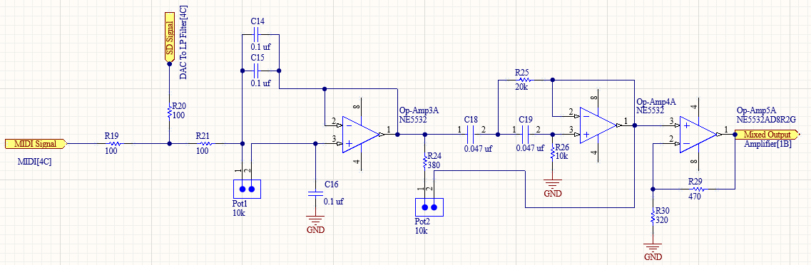
Audio PCB Schematic-Mixer to Filters
Notes:
Conor

Slide 23
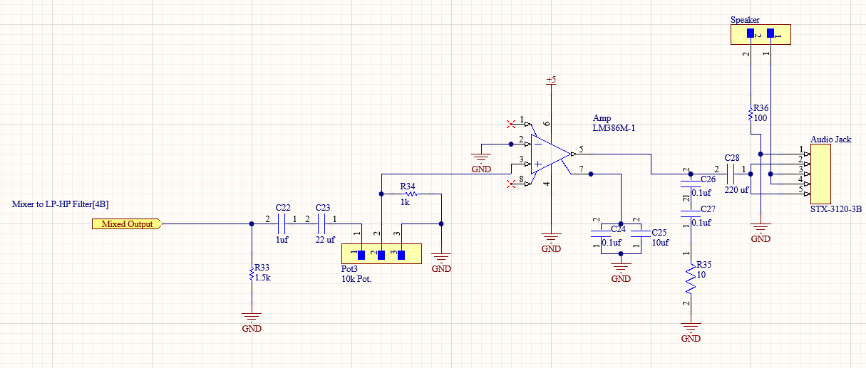
Audio PCB Schematic-Amplifier
Notes:
Conor

Slide 24
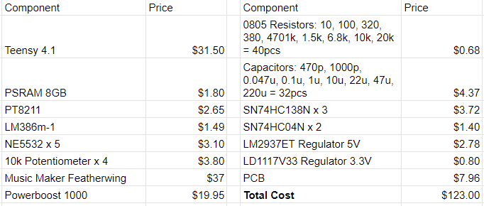
Audio PCB BoM
Notes:
Conor

Slide 25
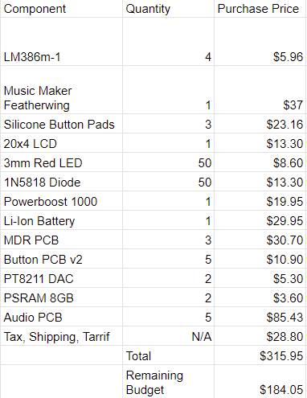
Budget
Notes:
Conor

Slide 26
FPR Deliverables - Complete Specification
Remaining Specification features
System outputs to wired or built-in speakers
Save and load a measure matrix
Device under the dimensions of a large tablet
Usability Improvements
Fully packaged in permanent enclosure
Multiple sound deletion capabilities (delete whole step, last step added, whole measure matrix)
Pause button functioning
Ability to edit beats per measure and different steps per beat for each beat
Notes:
Shawn or Evan Added Jay’s suggestion

Slide 27
FPR PCB- Audio Board
Revised low pass/ high pass filter design
Increased signal decoupling
Revised amplifier selection
Adding more power/ground pins
Revised decoder wiring
Notes:
Evan or Ryan or Conor

Slide 28
FPR Demonstration
Similar to CDR with changes
Build a measure from scratch
Save current track
Load previous track
Demonstrate deleting more than one sound at a time
Demonstrate variable beat & step counts

Slide 29
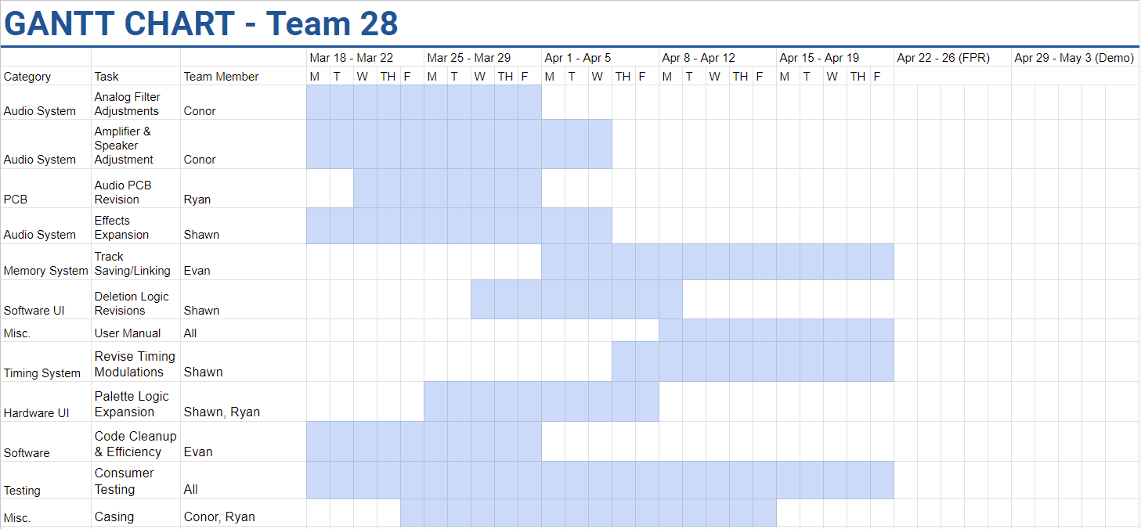
Notes:
Conor
Color-code by person
Fix fonts

Slide 30
CDR Deliverables and Demonstration
Button Matrix PCB integrated
Audio PCB integrated
Low and high pass filters functional
LCD displays MIDI sounds, SD sounds, BPM, steps per beat
Assign sounds from display to palette
Assign sounds from palette to measure matrix (LED indicating from which palette button
Overlap up 4 MIDI sounds and SD sounds on one step
Effects overlay measure matrix
Can change tempo using dial
Change number of steps per beat using LCD
Notes:
Move earlier before we talk about what we did
handheld->portable
Add LED lights on step played, and palette button pressed

Slide 31
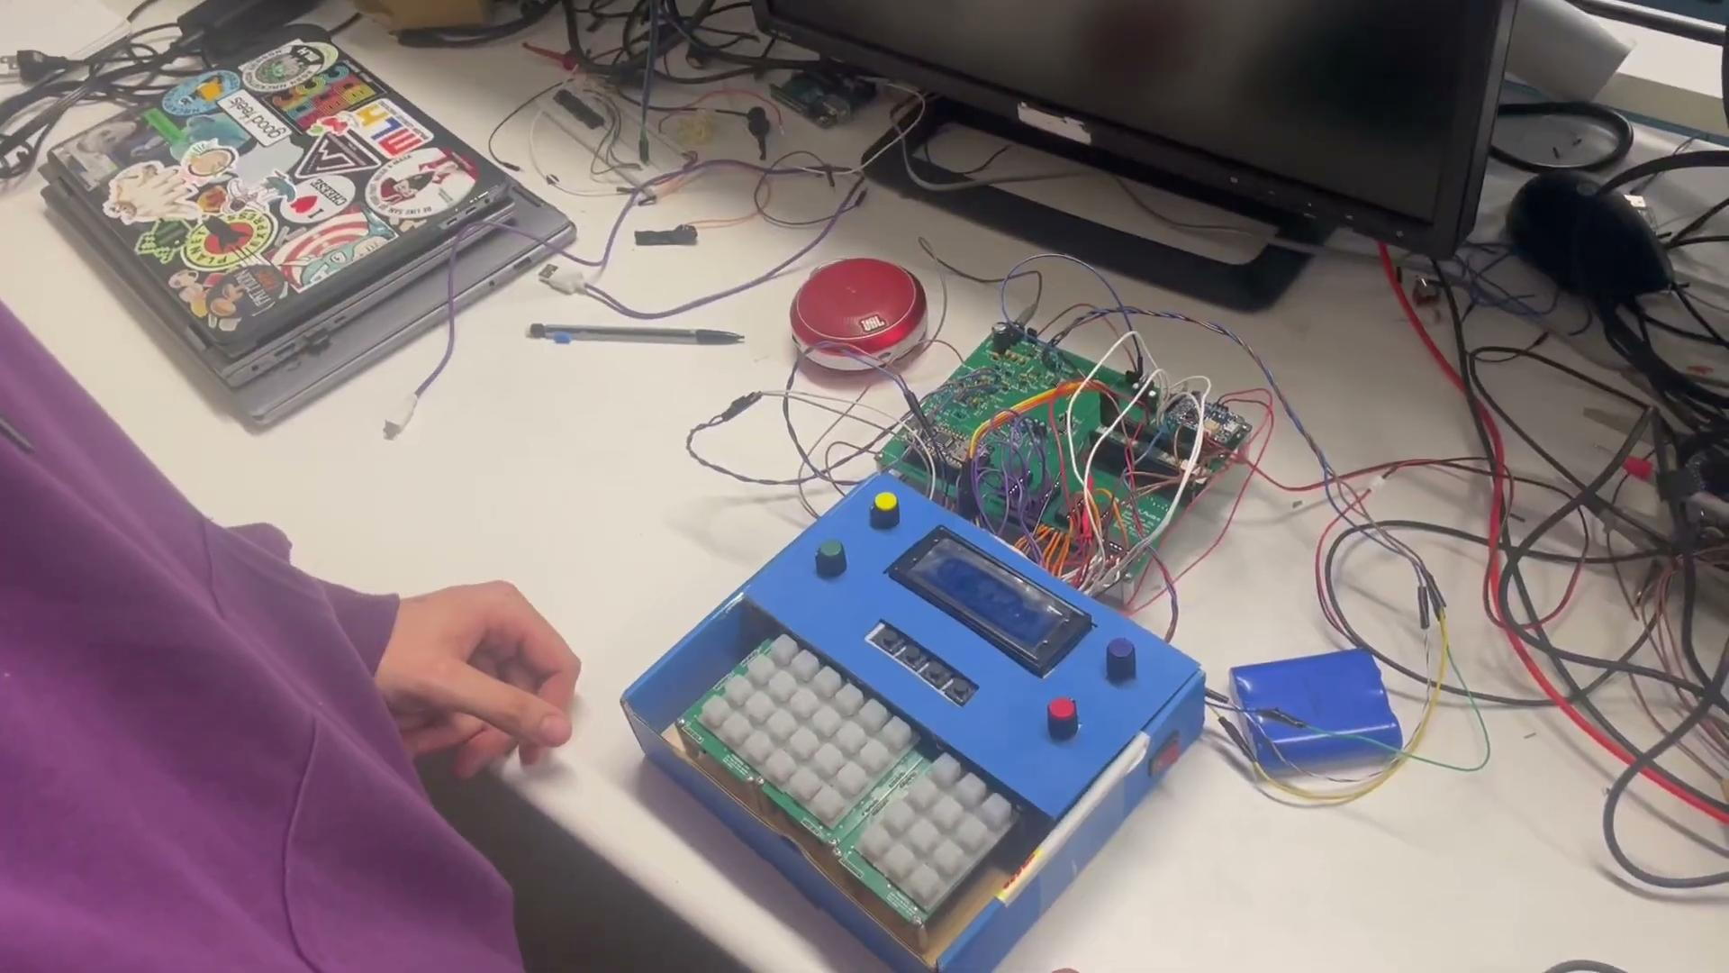
Demo Video

